Slide 1
Servlets, JSP, MVC
Anti Orgla, Nortal AS
18.03.2014

Slide 2
About me
Senior JAVA Developer @ Nortal AS
8 years of seeing this stuff
Written:
~10 Servlets
~Gazillion JSP files
~Hypergazillion MVCs.
anti.orgla@nortal.com

Slide 3
Agenda
JAVA EE + Web Containers
Servlet API
JSP
MVC
Filters, Listeners
What’s next?

Slide 4
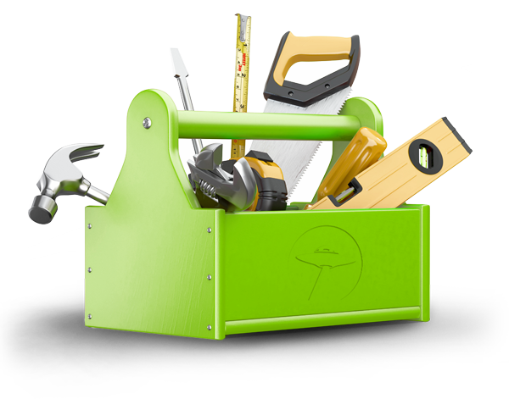
JAVA EE
Platform, that provides APIs for developing and running enterprise software
Web Applications
Web Services
Messaging
Persistence
etc…
JEE 7 28.05.2013

Slide 5

API
Application programming interface
Specifies „ground rules“
Specifies how software components should interact with each ohter

Slide 6
Web Application
Application software, that relies on web browser to render it
Building blocks in Java EE:
Web Container
Servlet
JSP

Slide 7
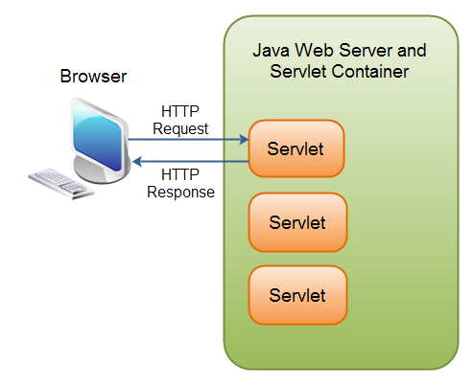
Web Container
Manages component
life cycles
Accepts requests, sends responses
Routes requests to
applications
http://tutorials.jenkov.com/java-servlets/overview.html

Slide 8
Web Containers
Apache Tomcat
JBoss
WebLogic
Jetty
Glassfish
Websphere
…

Slide 9
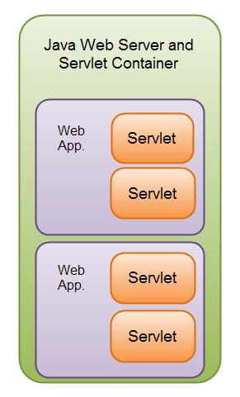
Web Containers
Multiple applications
inside one container
http://tutorials.jenkov.com/java-servlets/overview.html

Slide 10
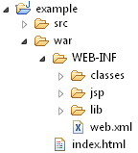
Application structure

Slide 11
Application structure
Java source files

Slide 12
Application structure
Document root

Slide 13
Application structure
Static content

Slide 14
Application structure
Configuration,
executable code

Slide 15
Application structure
Deployment descriptor

Slide 16
Application structure
Compiled classes

Slide 17
Application structure
Dependencies (JAR-s)

Slide 18
Application structure
Java Server Pages

Slide 19
Deployment descriptor (web.xml)
Instructs the container how handle this application
<?xml version="1.0" encoding="UTF-8"?>
<web-app xmlns="http://java.sun.com/xml/ns/javaee"
xmlns:xsi="http://www.w3.org/2001/XMLSchema-instance"
xsi:schemaLocation="http://java.sun.com/xml/ns/javaee http://java.sun.com/xml/ns/javaee/web-app_3_0.xsd"
version="3.0">
<welcome-file-list>
<welcome-file>index.html</welcome-file>
</welcome-file-list>
</web-app>

Slide 20
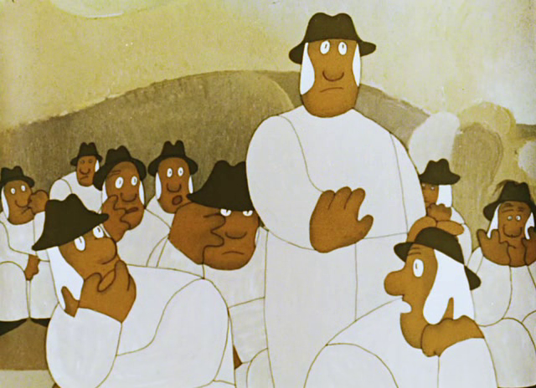
web.xml
In Servlet API version 3.0 most components of web.xml are replaced by annotations that go directly to Java source code.
Convention over configuration!
Examples later

Slide 21
Servlet
Java class, processes requests (in) and returns responses (out)
Are managed by a web container
javax.servlet.http.HttpServlet – abstract class, describes doXXX that are used for different type of HTTP method.
doGet();
doPost();

Slide 22
Servlet example
public class HelloServlet extends HttpServlet {
@Override
protected void doGet(HttpServletRequest req, HttpServletResponse resp)
throws ServletException, IOException {
PrintWriter writer = resp.getWriter();
writer.println("<html><head><title>Hello</title></head><body>");
writer.println("<p>Hello World!</p>");
writer.println("<p>Current time: " + new Date() + "</p>");
writer.println("</body></html>");
}
}

Slide 23
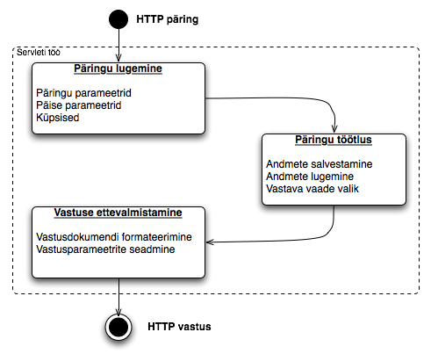
What would a Servlet do?

Slide 24
Servlet mapping
Before Servlet 3.0 web.xml
(stoneage mode)
<servlet>
<servlet-name>hello</servlet-name>
<servlet-class>example.HelloServlet</servlet-class>
</servlet>
<servlet-mapping>
<servlet-name>hello</servlet-name>
<url-pattern>/hello</url-pattern>
</servlet-mapping>

Slide 25
Servlet Mapping
In Servlet 3.0 via annotation
@WebServlet("/hello")
public class HelloServlet extends HttpServlet {
...

Slide 26
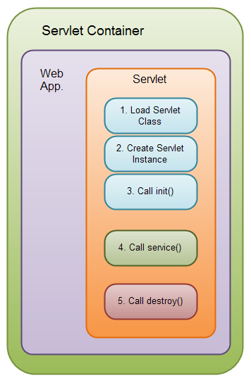
Servlet life cycle
http://tutorials.jenkov.com/java-servlets/servlet-life-cycle.html

Slide 27

Sessions
HTTP is a stateless protocol
How do we remember a user between requests?
Cookies
URL rewriting

Slide 28
Java HttpSession
HttpSession is a common interface for accessing session context
Actual implementation is provided by a Web Container

Slide 29
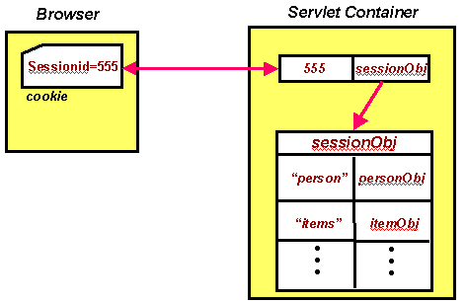
Java HttpSession
http://java.sun.com/developer/onlineTraining/JSPIntro/contents.html

Slide 30
HttpSession example
HttpSession session = req.getSession();
int visit;
if (session.isNew()) {
visit = 0;
} else {
visit = (Integer) session.getAttribute("visit");
}
session.setAttribute("visit", ++visit);

Slide 31

HttpServletRequest
Contains request information
Parameters:
String value = request.getParameter("name");
Attributes:
request.setAttribute(“key", value);
request.getAttribute(“key”);

Slide 32
HttpServletRequest
Also contains META data…
request.getMethod();
“GET”, “POST”, …
request.getRemoteAddr();
Remote client’s IP
request.getServletPath();
“/path/to/servlet”
…

Slide 33
HttpServletRequest
…and headers…
request.getHeaderNames();
Enumeration<String>
request.getHeader("User-Agent");
“Mozilla/5.0 (X11; Linux x86_64) …”

Slide 34
Request Headers
Accept | text/html,application/xhtml+xml,application/xml;q=0.9,*/*;q=0.8
Accept-Encoding | gzip, deflate
Accept-Language | et,et-ee;q=0.8,en-us;q=0.5,en;q=0.3
Connection | keep-alive
Cookie | JSESSIONID=C687CC4E2B25B8A27DAB4A5F30980583; __utma=111872281.1173964669.1316410792.1318315398.1338294258.52; oracle.uix=0^^GMT+3:00^p
Host | localhost:8080
User-Agent | Mozilla/5.0 (Windows NT 6.1; WOW64; rv:19.0) Gecko/20100101 Firefox/19.0

Slide 35
HttpServletRequest
…and cookies
Cookie[] cookies = request.getCookies();
cookie.getName();
cookie.getValue();
cookie.setValue(“new value”);

Slide 36
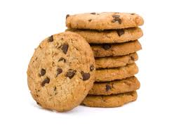
Cookie
Small piece of information (some ID, parameter, preference etc..)
Stored in browser
Usually sent by a server
Client sends only name-value pair
JSESSIONID = C687CC4E2B25B8A27DAB4A5F30980583
language=en
Name
Value
Expiry date
Path
Domain
Secure (can be sent over ssh only)
HttpOnly

Slide 37
HttpServletResponse
Allows to set response information
response.setHeader("Content-Type", "text/html");
response.addCookie(new Cookie("name", "value"));
Content-Language | et
Content-Type | text/html;charset=UTF-8
Date | Mon, 11 Mar 2013 06:48:54 GMT
Server | Apache-Coyote/1.1
Transfer-Encoding | chunked

Slide 38
HttpServletResponse
Add content
response.getWriter().println("...");
Write text
response.getOutputStream().write(...);
Write binary

Slide 39
Servlets – should I write one?
Writing HTML in Java is hideous
PrintWriter writer = resp.getWriter();
writer.println("<html><head><title>Hello</title></head><body>");
writer.println("<p>Hello World!</p>");
writer.println("<p>Current time: " + new Date() + "</p>");
writer.println("</body></html>");

Slide 40
JSP to the rescue!
JSP (Java Server Pages)
Write HTML
+standard markup language
Add dynamic scripting elements
Add Java code

Slide 41
JSP example
war/WEB-INF/jsp/hello.jsp
<%@page import="java.util.Date"%>
<html>
<head><title>Hello</title></head>
<body>
<p>Hello World!</p>
<p>Current time: <%= new Date() %></p>
</body>
</html>

Slide 42
JSP mapping
web.xml
<servlet>
<servlet-name>hello2</servlet-name>
<jsp-file>/WEB-INF/jsp/hello.jsp</jsp-file>
</servlet>
<servlet-mapping>
<servlet-name>hello2</servlet-name>
<url-pattern>/hello2</url-pattern>
</servlet-mapping>

Slide 43
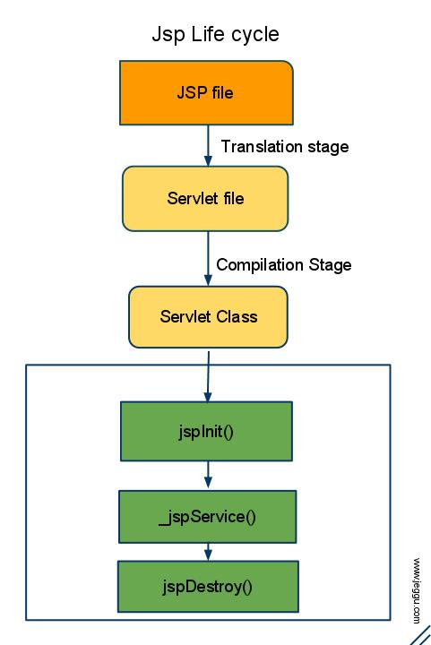
JSP life-cycle
http://www.jeggu.com/2010/10/jsp-life-cycle.html

Slide 44
Dynamic content
Expression
<p>Current time: <%= new Date() %></p>
Scriptlet
<p>Current time: <% out.println(new Date()); %></p>

Slide 45
Dynamic content
Declaration
<%!
private Date currentDate(){
return new Date();
}
%>
<p>Current time: <%= currentDate() %></p>

Slide 46
package org.apache.jsp.WEB_002dINF.jsp.document;
import javax.servlet.*;
import javax.servlet.http.*;
import javax.servlet.jsp.*;
import java.util.Date;
public final class testdokument_jsp extends org.apache.jasper.runtime.HttpJspBase
implements org.apache.jasper.runtime.JspSourceDependent {
private static final javax.servlet.jsp.JspFactory _jspxFactory =
javax.servlet.jsp.JspFactory.getDefaultFactory();
private static java.util.Map<java.lang.String,java.lang.Long> _jspx_dependants;
private javax.el.ExpressionFactory _el_expressionfactory;
private org.apache.tomcat.InstanceManager _jsp_instancemanager;
public java.util.Map<java.lang.String,java.lang.Long> getDependants() {
return _jspx_dependants;
}
public void _jspInit() {
_el_expressionfactory = _jspxFactory.getJspApplicationContext(getServletConfig().getServletContext()).getExpressionFactory();
_jsp_instancemanager = org.apache.jasper.runtime.InstanceManagerFactory.getInstanceManager(getServletConfig());
}
public void _jspDestroy() {
}
public void _jspService(final javax.servlet.http.HttpServletRequest request, final javax.servlet.http.HttpServletResponse response)
throws java.io.IOException, javax.servlet.ServletException {
final javax.servlet.jsp.PageContext pageContext;
javax.servlet.http.HttpSession session = null;
final javax.servlet.ServletContext application;
final javax.servlet.ServletConfig config;
javax.servlet.jsp.JspWriter out = null;
final java.lang.Object page = this;
javax.servlet.jsp.JspWriter _jspx_out = null;
javax.servlet.jsp.PageContext _jspx_page_context = null;
try {
response.setContentType("text/html; charset=UTF-8");
pageContext = _jspxFactory.getPageContext(this, request, response,
null, true, 8192, true);
_jspx_page_context = pageContext;
application = pageContext.getServletContext();
config = pageContext.getServletConfig();
session = pageContext.getSession();
out = pageContext.getOut();
_jspx_out = out;
out.write("\r\n");
out.write("\r\n");
out.write("<p>Current time: ");
out.print( new Date() );
out.write("</p>");
} catch (java.lang.Throwable t) {
if (!(t instanceof javax.servlet.jsp.SkipPageException)){
out = _jspx_out;
if (out != null && out.getBufferSize() != 0)
try { out.clearBuffer(); } catch (java.io.IOException e) {}
if (_jspx_page_context != null) _jspx_page_context.handlePageException(t);
else throw new ServletException(t);
}
} finally {
_jspxFactory.releasePageContext(_jspx_page_context);
}
}
}

Slide 47
Predefined variables
request – HttpServletRequest
response – HttpServletResponse
out – Writer
session – HttpSession
application – ServletContext
pageContext – PageContext

Slide 48
JSP actions
jsp:include Includes a file at the time the page is requested
jsp:forward Forwards the requester to a new page
jsp:getProperty Inserts the property of a JavaBean into the output jsp:setProperty Sets the property of a JavaBean
jsp:useBean Finds or instantiates a JavaBean

Slide 49
Expression Language (EL)
Easy way to access JavaBeans in different scopes
Total Sum: ${row.price * row.amount}

Slide 50
Basic Operators in EL
Operator | Description
. | Access a bean property or Map entry
[] | Access an array or List element
( ) | Group a subexpression to change the evaluation order
+ | Addition
- | Subtraction or negation of a value
* | Multiplication
/ or div | Division
% or mod | Modulo (remainder)
== or eq | Test for equality
!= or ne | Test for inequality
< or lt | Test for less than
> or gt | Test for greater than
<= or le | Test for less than or equal
>= or gt | Test for greater than or equal
&& or and | Test for logical AND
|| or or | Test for logical OR
! or not | Unary Boolean complement
empty | Test for empty variable values
http://www.tutorialspoint.com/jsp/jsp_expression_language.htm

Slide 51
Scopes
Many objects allow you to store attributes
ServletRequest.setAttribute
HttpSession.setAttribute
ServletContext.setAttribute

Slide 52
Scopes
ServletContext – web context, one per application/JVM
Session – one per user sessioon
Usually a browser sessioon
Request – scope of a specific request

Slide 53
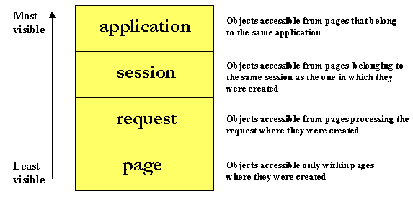
Scopes
http://java.sun.com/developer/onlineTraining/JSPIntro/contents.html

Slide 54
Scopes
<%
application.setAttribute("subject", "Web information systems");
session.setAttribute("topic", "Servlets");
request.setAttribute("lector", "Anti");
%>
Subject: ${subject}
Topic: ${topic}
Lector: ${lector}
Output:
Subject: Web information systems
Topic: Servlets
Lector: Anti

Slide 55
Scopes
<%
application.setAttribute("subject", "Web information systems");
session.setAttribute("topic", "Servlets");
request.setAttribute("lector", "Anti");
pageContext.setAttribute("subject", "The new topic");
application.setAttribute("subject", "The newest topic");
%>
Subject: ${subject}
Topic: ${topic}
Lector: ${lector}
What will be the output?

Slide 56
Scopes
<%
application.setAttribute("subject", "Web information systems");
session.setAttribute("topic", "Servlets");
request.setAttribute("lector", "Anti");
pageContext.setAttribute("subject", "The new topic");
application.setAttribute("subject", "The newest topic");
%>
Subject: ${subject}
Topic: ${topic}
Lector: ${lector}
Subject: The new topic
Topic: Servlets
Lector: Anti

Slide 57
JavaBeans
public class Person implements Serializable {
private String name;
public Person() {}
public String getName() {
return name;
}
public void setName(String name) {
this.name = name;
}
}

Slide 58
JavaBeans in EL
Person person = new Person();
person.setName(„Anti");
request.setAttribute("person", person);
<p>Person: ${person.name}</p>

Slide 59
Java Standard Tag Library (JSTL)
Set of standard tools for JSP
<%
List<String> lectors = Arrays.asList(„Jack", „Jill", „Anti");
pageContext.setAttribute("lectors", lectors);
%>
<c:set var="guestLector" value=„Anti" />
<c:forEach var="lector" items="${lectors}">
Name: ${lector}
<c:if test="${lector eq guestLector}“>(guest)</c:if>
<br />
</c:forEach>

Slide 60
Problem with JSP
Writing Java in JSP is hideous
<p>Current time: <%= currentDate() %></p>

Slide 61
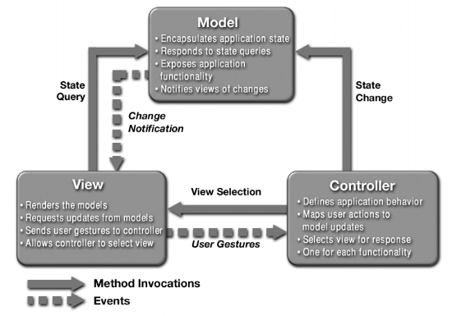
MVC to the resque!
http://java.sun.com/blueprints/patterns/MVC-detailed.html

Slide 62
Servlet controller, JSP view
protected void doGet(HttpServletRequest req, HttpServletResponse resp) throws ServletException, IOException {
req.setAttribute("currentDate", new Date());
req.getRequestDispatcher("/WEB-INF/jsp/hello.jsp").forward(req, resp);
}

Slide 63
Servlet controller, JSP view
WEB-INF/jsp/hello.jsp
<html>
...
<body>
<p>Current time: ${currentDate}</p>
</body>
</html>

Slide 64
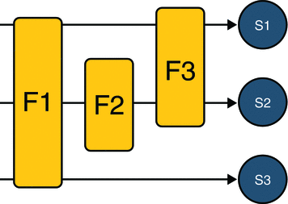
Filters
Allows you to do something before, after or instead of servlet invocation.
Filter chain
http://docs.oracle.com/javaee/5/tutorial/doc/bnagb.html

Slide 65
Filter example
public class LoggingFilter implements Filter {
public void doFilter(ServletRequest request, ServletResponse response, FilterChain chain) throws IOException, ServletException {
long start = System.currentTimeMillis();
chain.doFilter(request, response);
long end = System.currentTimeMillis();
System.out.println("Time spent: " + (end - start));
}
}

Slide 66
Filter declaration
Before Servlet 3.0 in web.xml
<filter>
<filter-name>loggingFilter</filter-name>
<filter-class>example.LoggingFilter</filter-class>
</filter>
<filter-mapping>
<filter-name>hello</filter-name>
<url-pattern>/*</url-pattern>
</filter-mapping>

Slide 67
Filter declaration
In Servlet 3.0 via annotation
@WebFilter("/*")
public class LoggingFilter implements Filter {
...

Slide 68
Life-cycle event listeners
javax.servlet.ServletContextListener
javax.servlet.ServletContextAttributeListener
javax.servlet.ServletRequestListener
javax.servlet.ServletRequestAttributeListener
javax.servlet..http.HttpSessionListener
javax.servlet..http.HttpSessionAttributeListener

Slide 69
Listener example
public class LoggingRequestListener implements ServletRequestListener {
@Override
public void requestInitialized(ServletRequestEvent event) {
System.out.println("Received request from " + event.getServletRequest().getRemoteAddr());
}
@Override
public void requestDestroyed(ServletRequestEvent event) {}
}

Slide 70
Listener declaration
Before Servlet 3.0 in web.xml
<listener>
<listener-class>
example.LoggingRequestListener
</listener-class>
</listener>

Slide 71
Listener declaration
In Servlet 3.0 via annotation
@WebListener
public class LoggingRequestListener implements ServletRequestListener {
...

Slide 72
Servlet + JSP
It is not hideous but it is not great either.

Slide 73
Frameworks to the resque!
Most JAVA frameworks simplify application building – probably you won’t write servlets, JSP scriptlets etc..
So why should I care?

Slide 74
Back to basics
You are still going to deploy your applications into a web container.
Most frameworks use Servlet API as a backbone
Many traditional frameworks use JSP as the view technology.
Knowing what goes on behind the scenes makes you a true puppetmaster!

